Slide 1
Integration of Machine Learning Algorithms for Precision Crop Recommendations

Slide 2
TABLE OF CONTENTS
01
02
03
06
07
08
04
05
INTRODUCTION
MOTIVATION
OBJECTIVE
PROBLEM STATEMENT
LITERATURE REVIEW
09
10
DATA
FEATURES & TYPES
METHODOLOGY
RESULT
ANALYSIS
CHALLENGES
FUTURE
WORK & CONCLUSION
1

Slide 3
Supervised by:
Assistant Professor Ms. Tahsin Aziz
Presented by:
Hasan Rafsanzani Rahman
Tabassum Jahan Lamia
Naisha Mahiat Chowdhury
Fariha Hassan
Shree Shovon Chowdhury
190104052
190204077
190204089
190204109
190204111
Group No. 4425
Date of presentation: 03 April, 2024
2

Slide 4
INTRODUCTION
Challenges include poor crop choices and lack of awareness about land history, hindering progress.
Agriculture, employing over 50% of Bangladesh's population and occupying 76.06% of the land, is vital for development.
Proposed ML-based system considers soil parameters, using algorithms like SVM and Random Forest.
Aims to guide farmers in selecting suitable crops, enhancing sustainability and reducing resource usage.
3

Slide 5
MOTIVATION
Bangladesh faces land and water scarcity in agriculture.
Farmers lack technology access for decision-making.
A user-friendly ML model predicts suitable crops.
Economic viability and sustainability are priorities.
ML analyzes market trends for crop recommendations.
4

Slide 6
RESEARCH GAP
No studies on crop recommendation in Bangladesh.
Absence of research on crop recommendation datasets in Bangladesh.
Addressing this gap can boost agricultural productivity, crucial for Bangladesh's economy.
Creating new dataset
5

Slide 7
OBJECTIVE
Recommend crops based on soil features for quality production.
Collect soil characteristics, nutrients (N, P, K) and weather information for 35 crops.
Clear guidance on suitable crops for specific land and time of year.
Improved crop quality and increased production.
6

Slide 8
PROBLEM STATEMENT
Despite being agriculturally focused, Bangladesh's outdated data methods hinder global alignment.
Improved data collection is vital for digital crop recommendations, especially for farmers with limited modern knowledge.
Bridging data gaps and offering digital advice empowers all farmers, fostering a more sustainable farming environment in Bangladesh.
7

Slide 9
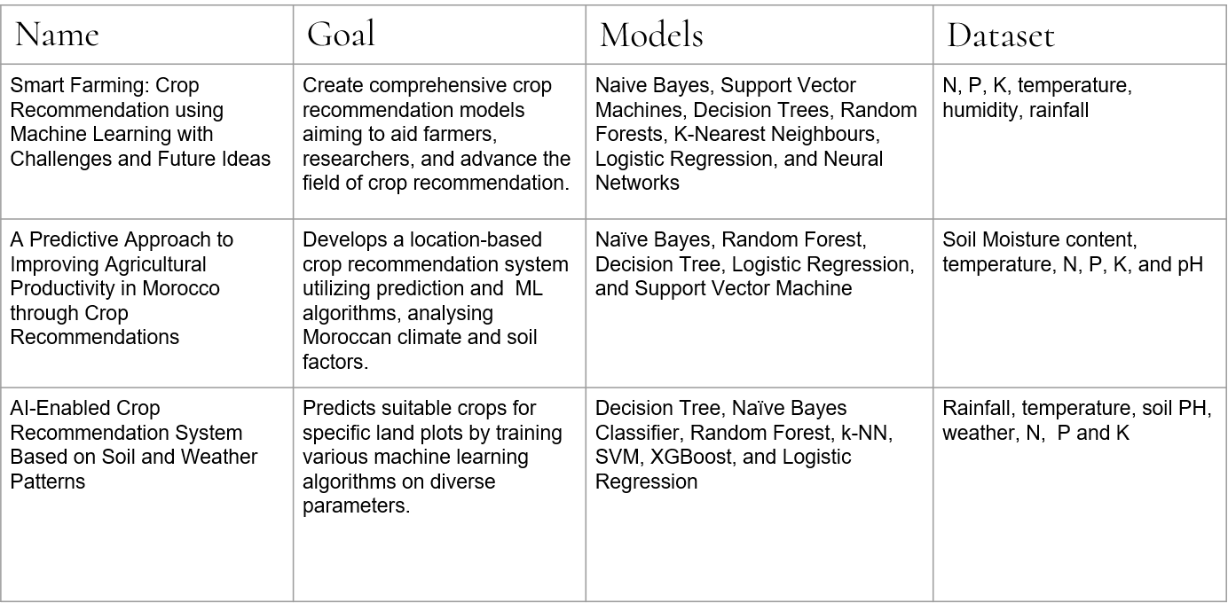
LITERATURE REVIEW
8

Slide 10
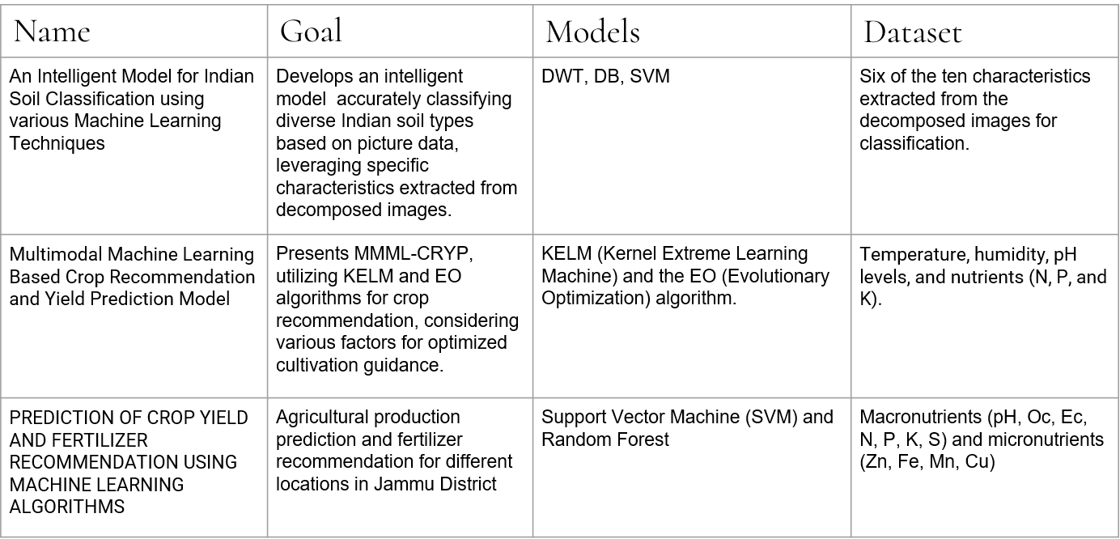
LITERATURE REVIEW
9

Slide 11
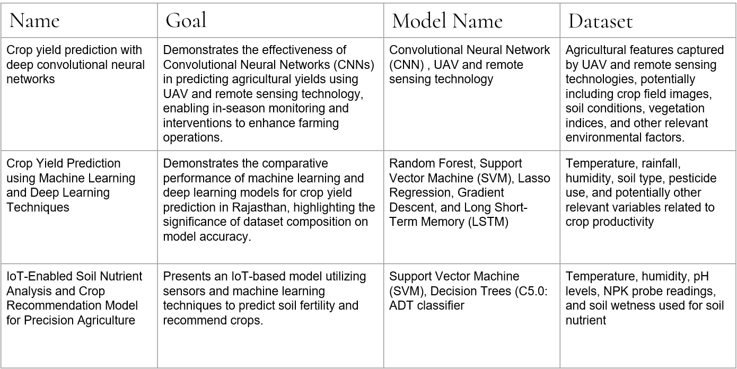
LITERATURE REVIEW
10

Slide 12
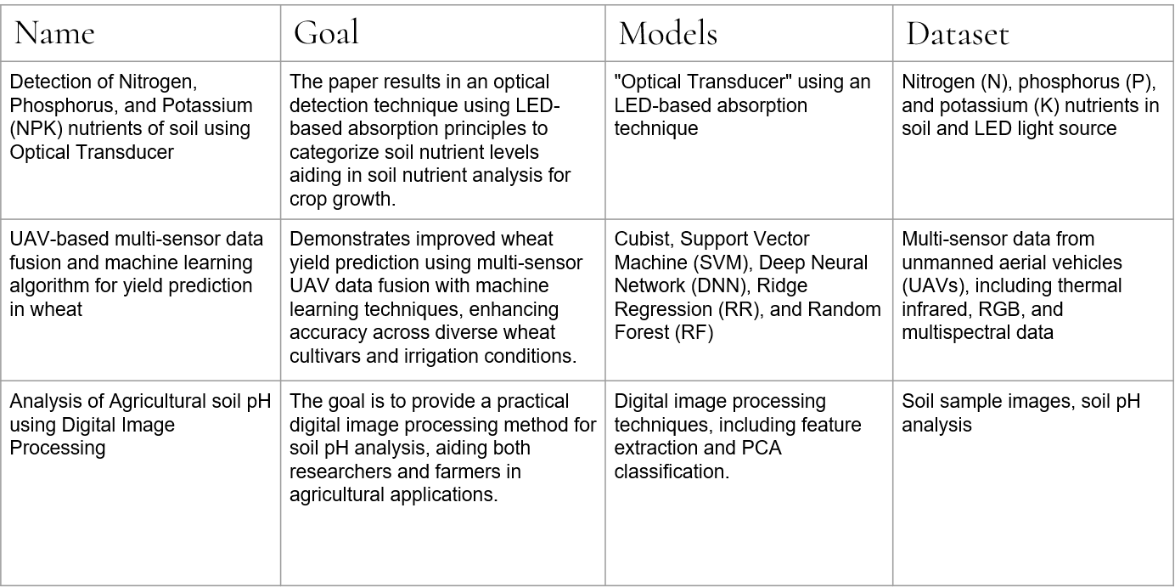
LITERATURE REVIEW
11

Slide 13
DATA FEATURES
LAND TYPE | Land types direct crop adaptation to varied topography and climate.
LAND LEVEL | Affects cultivation by influencing water and drainage in agriculture.
WATER RECESSION | Helps in root development, prevents waterlogging and nutrient absorption.
DRAINAGE | Prevents waterlogging, ensuring oxygen levels for root health.
CONSISTENCY | Influences water retention, aeration, and root development.
SOIL TEXTURE | Influences water retention, drainage, nutrient availability.
12

Slide 14
DATA FEATURES
SALINITY | Excessive salinity hinders water uptake and nutrient absorption.
SOIL MOISTURE | Facilitates nutrient absorption and metabolic processes for growth.
PERIOD | Specific phase of plant's growth.
pH | Impacting nutrient availability and influencing plant growth.
PRODUCTION | Production quantity of crops per hectare.
N, P, K | Chemical nutrients needed for the growth of crops.
Temperature | Optimal temperatures in Bangladesh favorable conditions for crop cultivation.
Rainfall | Bangladesh's ample rainfall sustains thriving crop cultivation.
13

Slide 15
DATA TYPES
LAND TYPE
LAND LEVEL
High Land
Middle High Land
Middle Low Land
Low Land
Extreme Low Land
Even
Uneven
Slope
WATER RECESSION
Too Early
Early
Natural
Late
14

Slide 16
DATA TYPES
DRAINAGE
SOIL TEXTURE
Best
Slightly Better
Slightly Bad
Bad
Worst
Loamy
Clay
Sandy
Sandy Loamy
Clay Loamy
CONSISTENCY
Strong
Crumbly
Loose
15

Slide 17
DATA TYPES
SALINITY
SOIL MOISTURE
Non Salinity
Slight Salinity
Irrigated
Non Irrigated
PERIOD
pH
Rabi (November-April)
Kharif-1 (April-October)
Khraif-2 (October-Early next year)
Excessive Acidic
Mild Acidic
Neutral
Mild Alkalinity
Excessive Alkalinity
16

Slide 18
NUTRIENTS
Potassium
Phosphorous
Nitrogen
Helps the overall functions of the plant perform correctly.
Responsible for root growth and flower and fruit development.
Largely responsible for the growth of leaves on the plant.
17

Slide 19
WEATHER CHARACTERISTICS
Temperature
Rainfall
Rainfall is the amount of rain that falls in a place during a particular period
Temperature is the measure of hotness or coldness expressed in terms of any of several scales, including Fahrenheit and Celsius.
18

Slide 20
DATA SAMPLE
Land Type | Land Level | Water Recessi-on | Drainage | Soil Texture | Consisten-cy | Salinity | Available Soil Moisture | Period | ph | Production (t/ha) | N | P | K | Temperature | Rainfall(mm) | Label
High Land | Even | Too Early | Best | Loamy | Crumbly | Non Salinity | Irrigated | Rabi | 5.738 | 30 | 132.262 | 28.715 | 92.2625 | 33.2625 | 14.7987 | Potato
Medium High Land | Uneven | Early | Slightly Better | Etel Loamy | Strong | Non Salinity | Irrigated | Rabi | 6.606 | 30 | 134.153 | 30.9841 | 94.1534 | 35.1534 | 18.3914 | Potato
Low Land | Even | Natural | Bad | Loamy | Crumbly | Non Salinity | Irrigated | Rabi | 7.869 | 30 | 130.943 | 27.1319 | 90.9432 | 31.9432 | 12.2922 | Potato
Medium High Land | Uneven | Natural | Slightly Bad | Sandy Loamy | Strong | Slight Salinity | Irrigated | Rabi | 5.181 | 30 | 130.153 | 26.1843 | 90.1536 | 34.8498 | 15.2882 | Potato
Extreme Low Land | Slope | Late | Worst | Loamy | Loose | Slight Salinity | Irrigated | Rabi | 8.795 | 30 | 134.751 | 31.7018 | 94.7515 | 32.7365 | 17.3849 | Potato
19

Slide 21
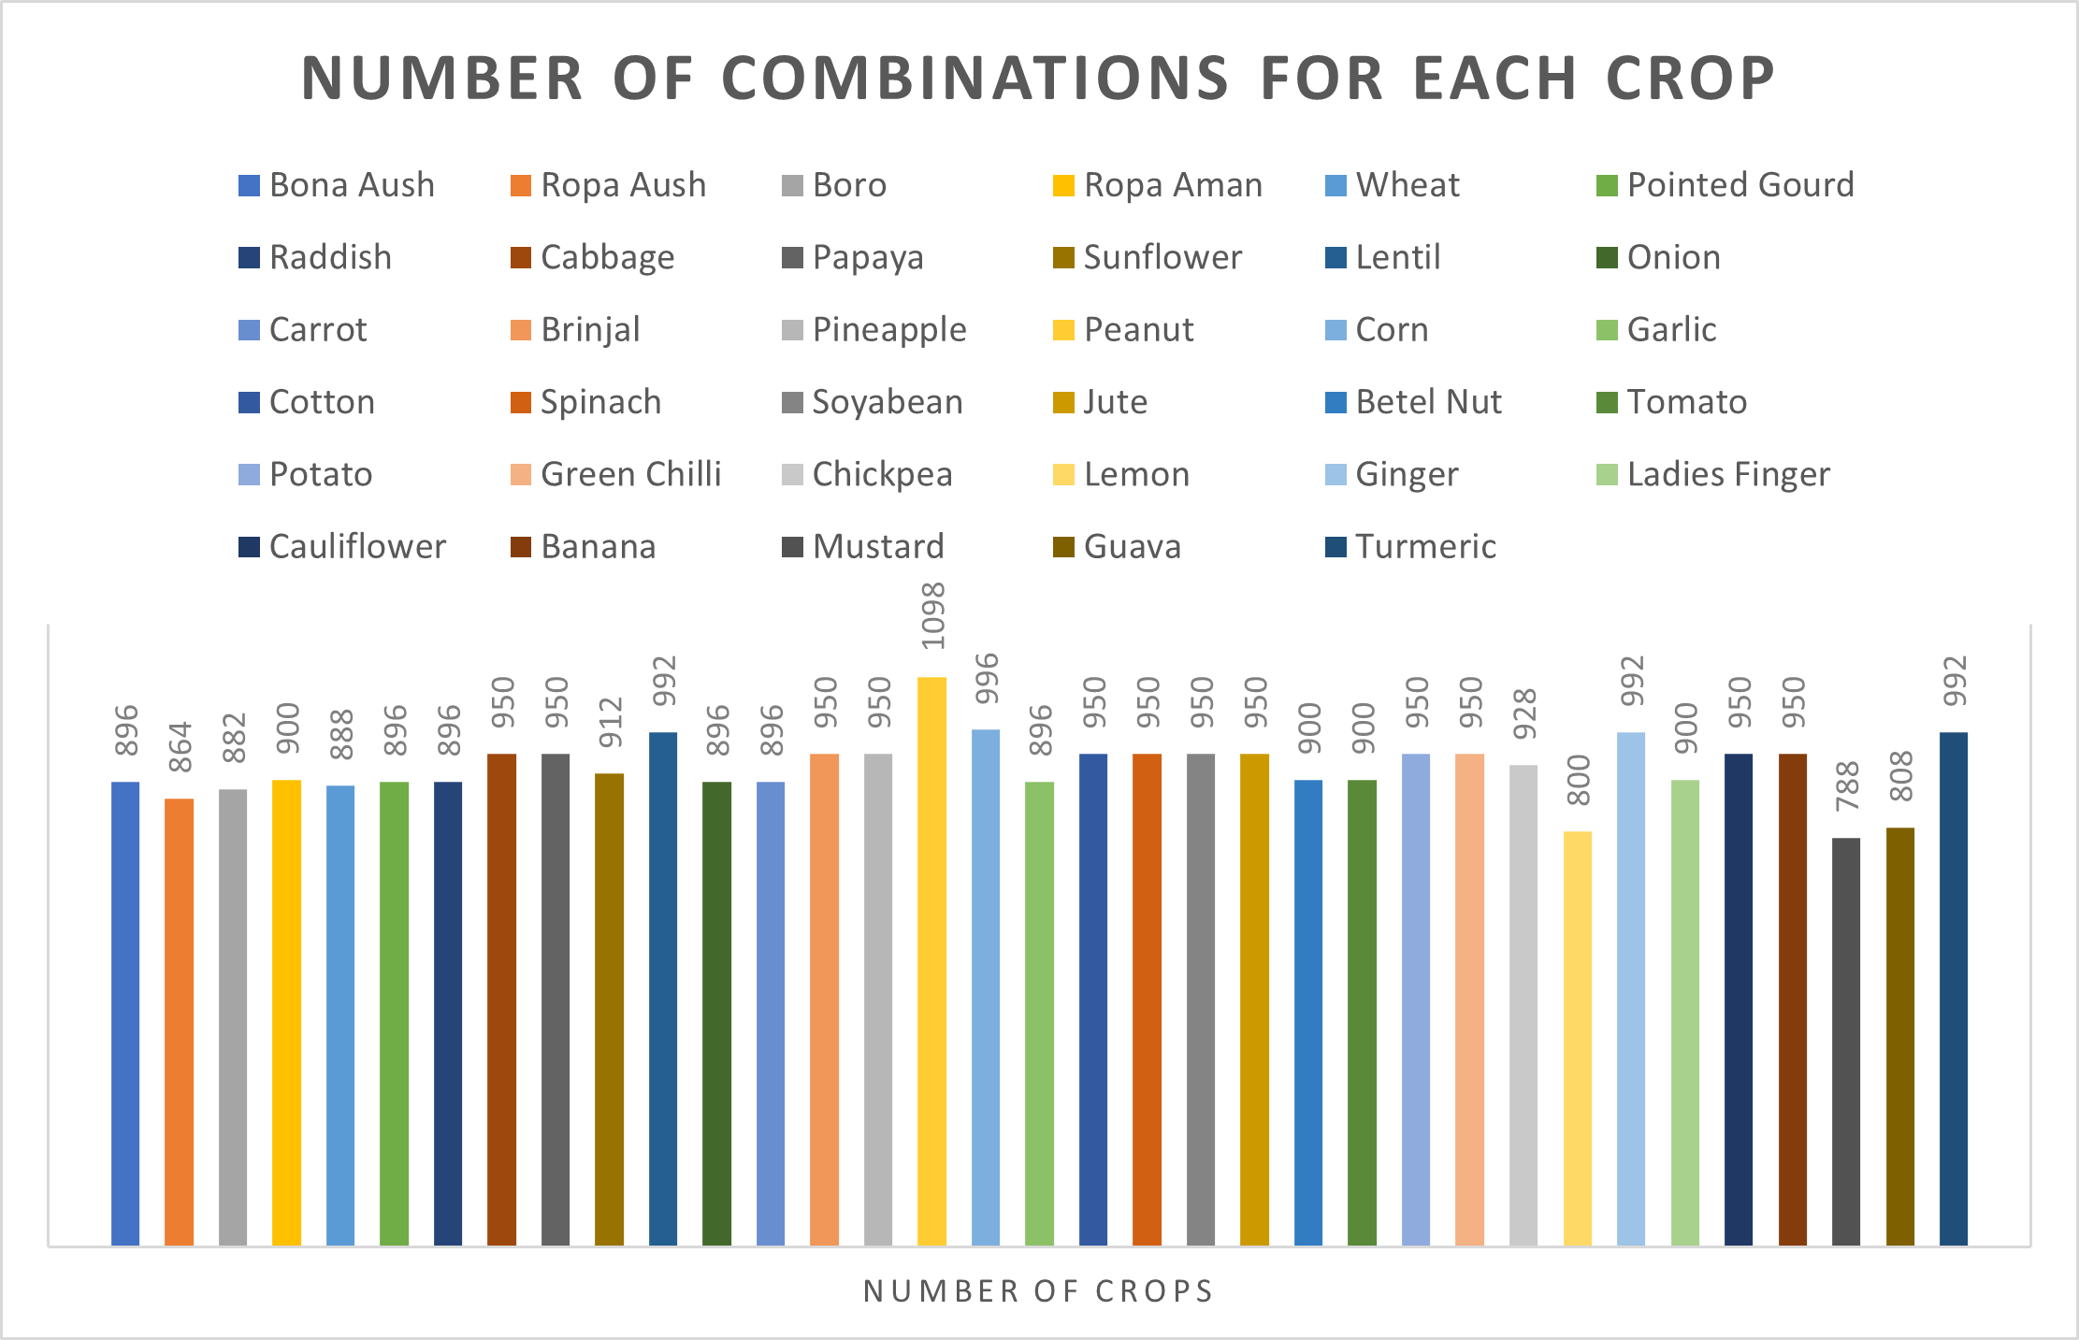
20

Slide 22
METHODOLOGY
Fig: Proposed Methodology
21

Slide 23
DATASET PREPROCESSING
Physical Soil
Characteristics
Removing Extra rows
Soil Nutrients
Combine Dataset
Processed
Dataset
Resampling
Weather Characteristics
Fig: Dataset Preprocessing
22

Slide 24
DROPPING ROWS WITH EMPTY CELLS
Land Type | Land Level | Water Recessi-on | Drainage | Soil Texture | Consisten-cy | Salinity | Available Soil Moisture | Period | ph | Production (t/ha) | N | P | K | S | Label
High Land | Even | Too Early | Best | Loamy | Crumbly | Non Salinity | Irrigated | Rabi | 5.738 | 30 | 132.262 | 28.715 | 92.2625 | 9.4525 | Potato
Middle High Land | Uneven | Early | Slightly Better | Loamy | Strong | Non Salinity | Irrigated | Rabi | 6.606 | 30 | 134.153 | 30.9841 | 94.1534 | 9.8307 | Potato
Low Land | Even | Natural | Bad | Loamy | Crumbly | Non Salinity | Irrigated | Rabi | 7.869 | 30 | 130.943 | 27.1319 | 90.9432 | 9.1886 | Potato
Middle Low Land | Uneven | Natural | Slightly Bad | Loamy | Strong | Slight Salinity | Not Irrigated | Kharif-1 | 5.181 | 30 | 130.153 | 26.1843 | 90.1536 | 9.0307 | Potato
Extreme Low Land | Slope | Late | Worst | Loamy | Loose |  | Not Irrigated | Kharif-1 | 8.795 | 30 | 134.751 | 31.7018 | 94.7515 | 9.9503 | Potato
23

Slide 25
DROPPING ROWS WITH EMPTY CELLS
Land Type | Land Level | Water Recessi-on | Drainage | Soil Texture | Consistency | Salinity | Available Soil Moisture | Period | ph | Production (t/ha) | N | P | K | S | Label
High Land | Even | Too Early | Best | Loamy | Crumbly | Non Salinity | Irrigated | Rabi | 5.738 | 30 | 132.262 | 28.715 | 92.2625 | 9.4525 | Potato
Middle High Land | Uneven | Early | Slightly Better | Loamy | Strong | Non Salinity | Irrigated | Rabi | 6.606 | 30 | 134.153 | 30.9841 | 94.1534 | 9.8307 | Potato
Low Land | Even | Natural | Bad | Loamy | Crumbly | Non Salinity | Irrigated | Rabi | 7.869 | 30 | 130.943 | 27.1319 | 90.9432 | 9.1886 | Potato
Middle Low Land | Uneven | Natural | Slightly Bad | Loamy | Strong | Slight Salinity | Not Irrigated | Kharif-1 | 5.181 | 30 | 130.153 | 26.1843 | 90.1536 | 9.0307 | Potato
24

Slide 26
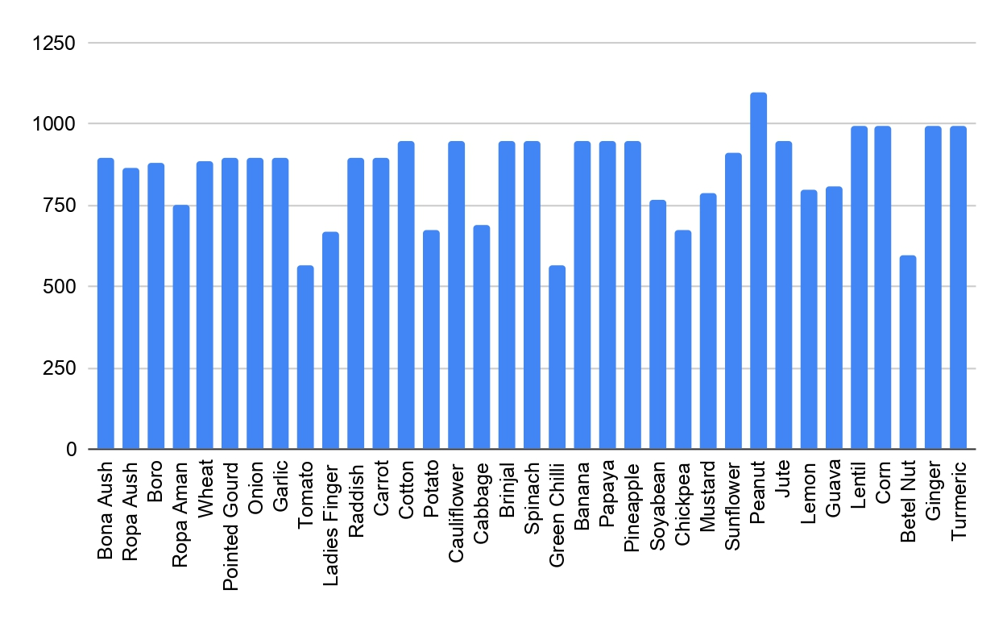
BEFORE RESAMPLING
Fig: No. of combinations for each crop before resampling
25

Slide 27
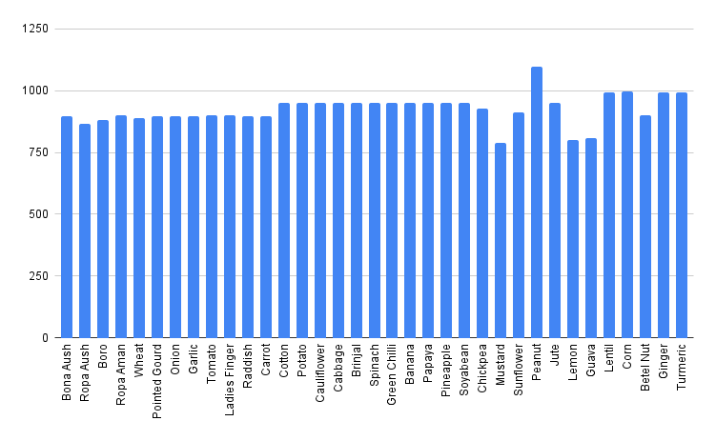
AFTER RESAMPLING
Fig: No. of combinations for each crop after resampling
26

Slide 28
VERIFICATION
Mst. Arifunnahar
Principal Scientific Officer (BCS Agriculture), DPS & ICT Section
Soil Resource Development Institute
Ministry of Agriculture
Dr. Faridul Alam
Principal Scientific Officer,
Soil Unit Natural Resources
Management Division
BARC (Bangladesh Agricultural Research Council)
Md. Jalal Uddin
Managing Director, BCS(Agriculture)
Soil Resource Development Institute
27

Slide 29
ML MODELS
Random Forest
Decision Tree
Support Vector Machine
K Nearest Neighbour
Logistic Regression
Naïve Bayes
28

Slide 30
RESUTL ANALYSIS
MODELS | ACCUARCY | RECALL | PRECISION | F1-SCORE
Random Forest | 99.89% | 99.89% | 99.88% | 99.89%
Decision Tree | 99.81% | 99.81% | 99.88% | 99.88%
SVM | 99.81% | 99.81% | 99.80% | 99.80%
KNN | 99.00% | 99.01% | 98.96% | 98.95%
Logistic Regression | 99.33% | 99.33% | 99.04% | 99.18%
Naïve Bayes | 83.36% | 83.36% | 84.51% | 79.33%
Table: Comparison of models
29

Slide 31
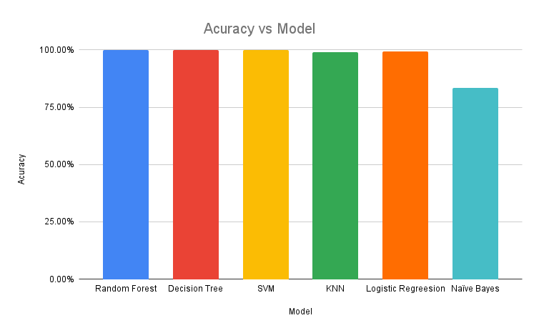
RESULT ANALYSIS
Graph: Accuracy vs Models
30

Slide 32
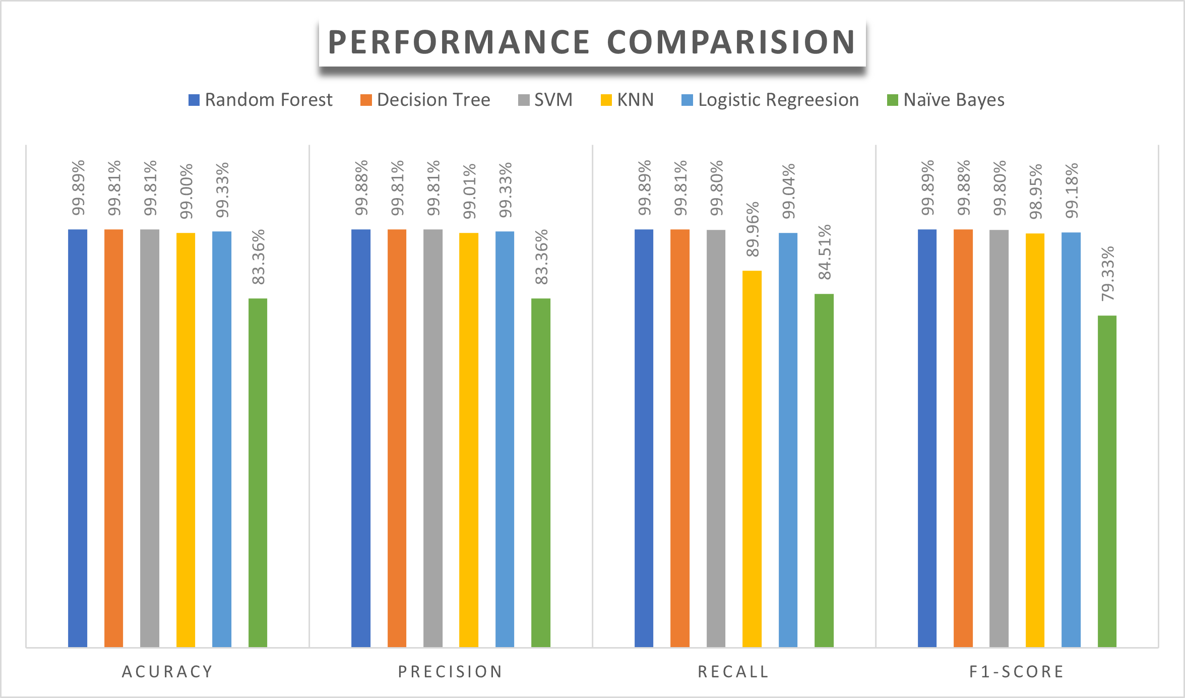
RESULT ANALYSIS
Graph: Performance Analysis
31

Slide 33
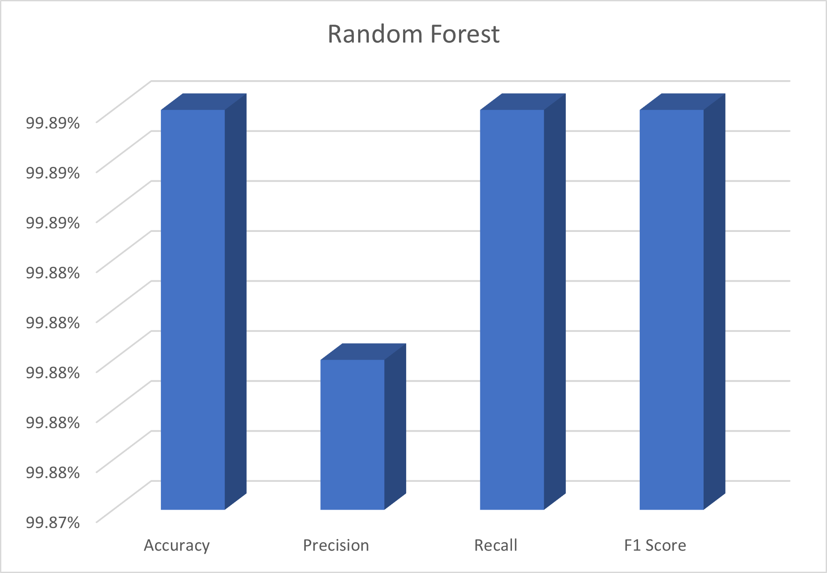
RESULT ANALYSIS
Graph: Result Analysis of Random Forest
32

Slide 34
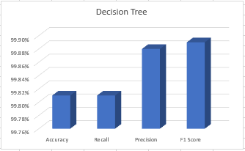
RESULT ANALYSIS
Graph: Result Analysis of Decision Tree
33

Slide 35
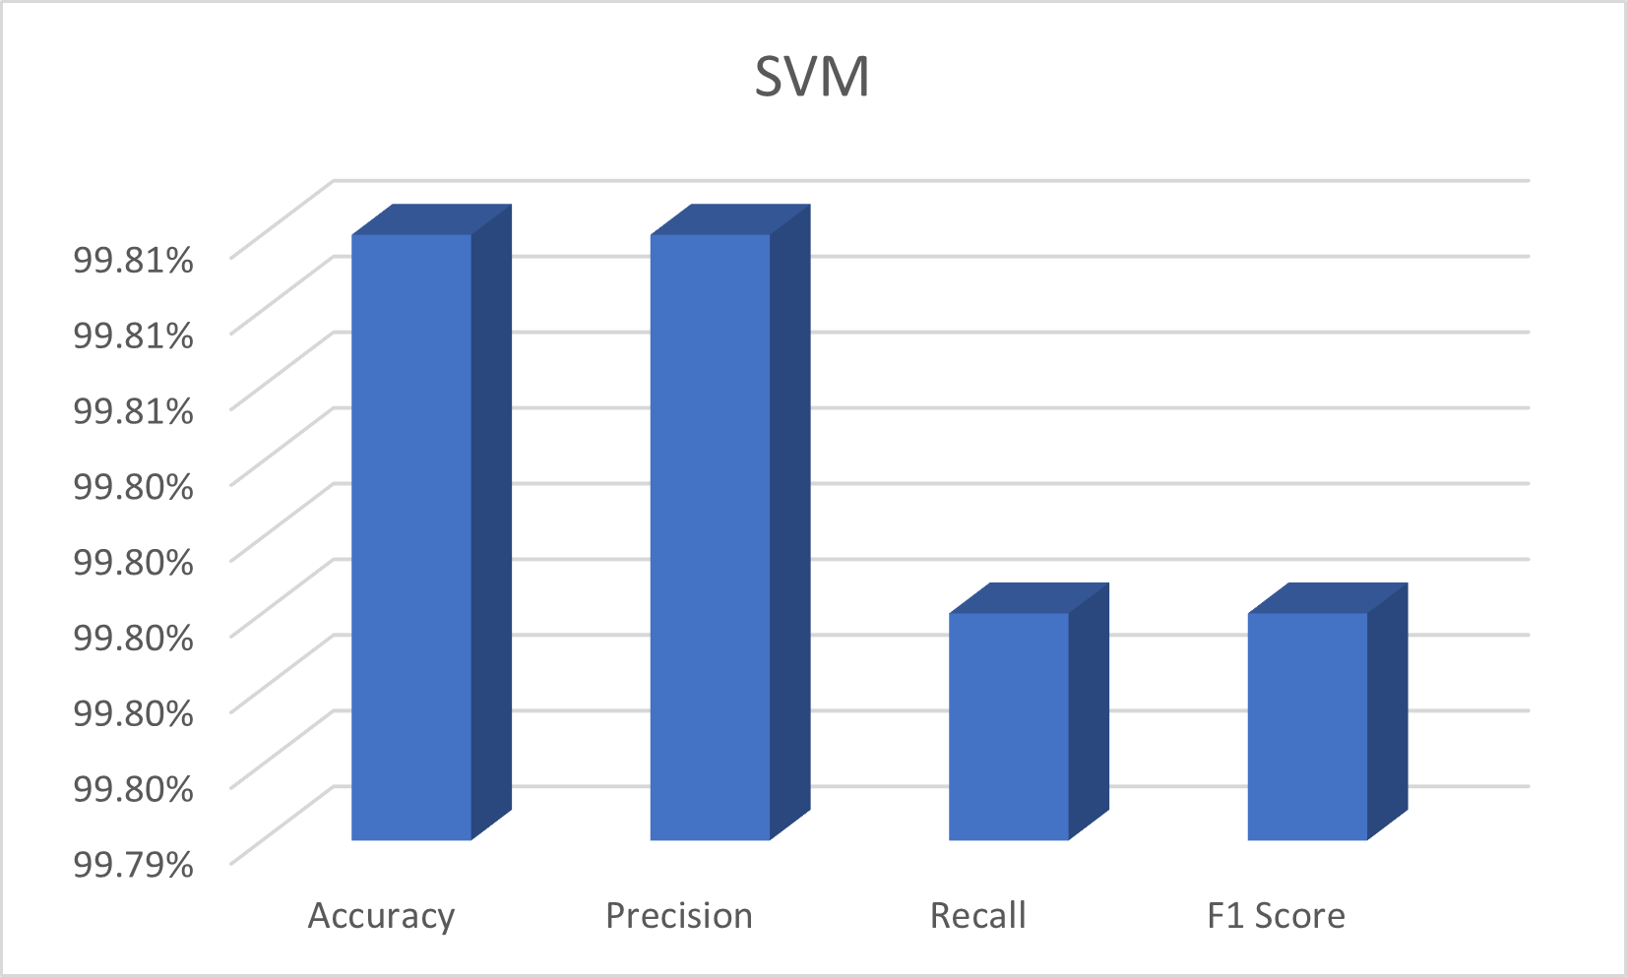
RESULT ANALYSIS
Graph: Result Analysis of SVM
34

Slide 36
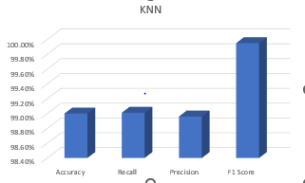
RESULT ANALYSIS
Graph: Result Analysis of KNN
35

Slide 37
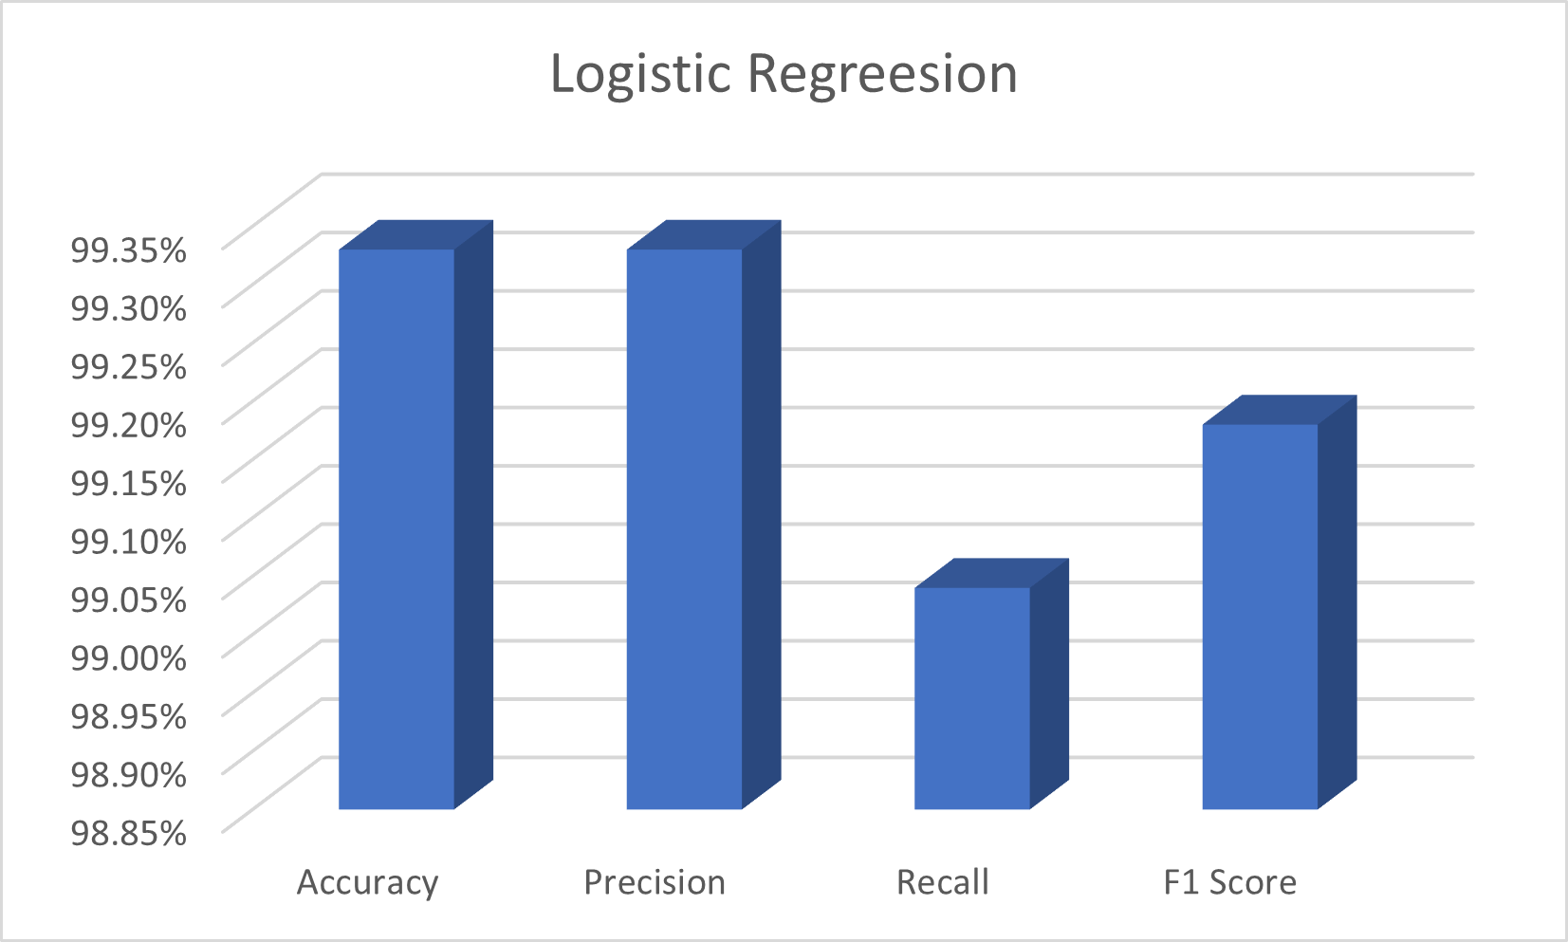
RESULT ANALYSIS
Graph: Result Analysis of Logistic Regression
36

Slide 38
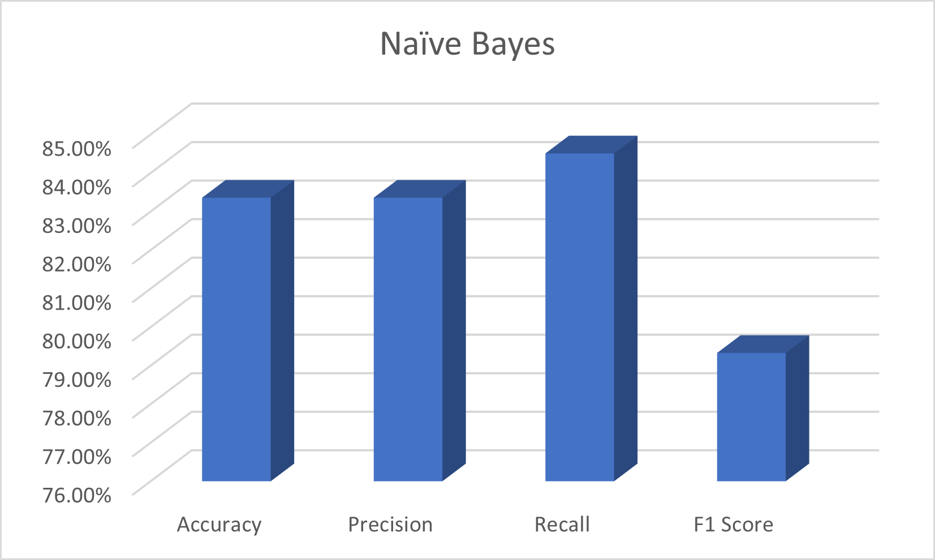
RESULT ANALYSIS
Graph: Result Analysis of Naïve Bayes
37

Slide 39
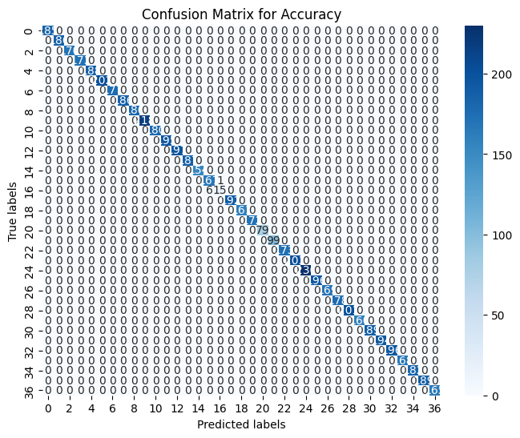



CONFUSION MATRIX
Fig: Confusion matrix of Decision Tree
38

Slide 40
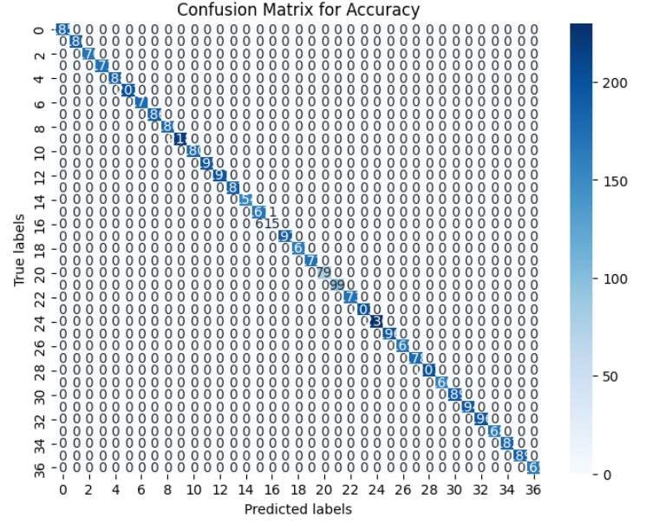

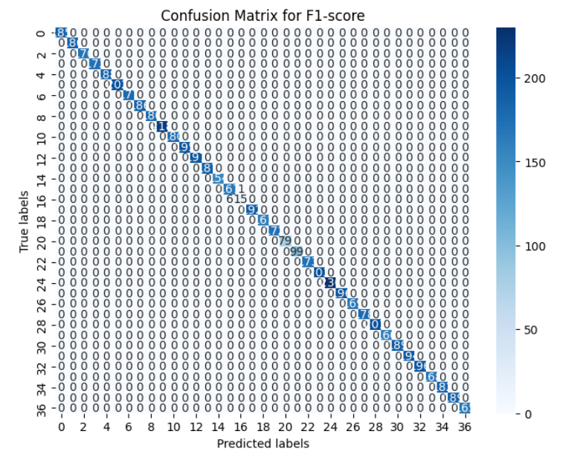
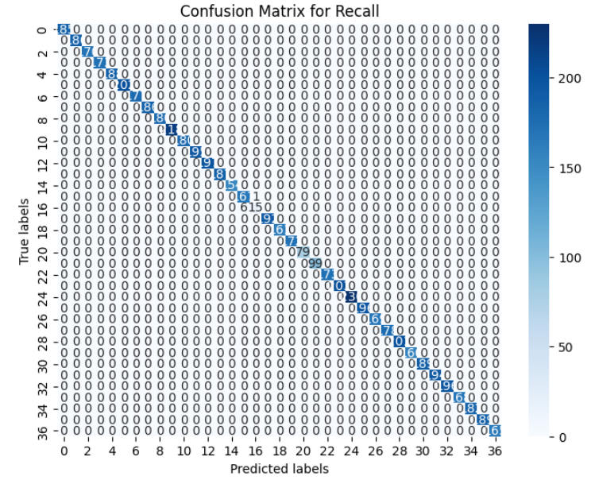
CONFUSION MATRIX
Fig: Confusion matrix of Random Forest
39

Slide 41
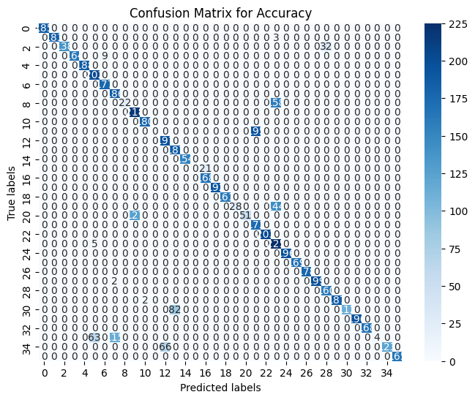



CONFUSION MATRIX
Fig: Confusion matrix of Naïve Bayes
40

Slide 42
CHALLENGES
Difficulty in finding required information.
Difficulty in translating Bengali information into English.
Difficulty in verification of the translated information by experts.
41

Slide 43
FUTURE WORK
Conduct comprehensive cost-benefit analyses considering production rates, field sizes, and financial aspects.
Fertilizer recommendation to the farmers.
Anticipate significant improvements in productivity and financial gains for farmers through this approach.
42

Slide 44
CONCLUSION
Stresses precision crop advice in Bangladesh's varied agro-ecology.
Advocates ongoing research for sustainable agriculture.
Recommends a technology-driven strategy.
43

Slide 45
THANK YOU!
Any questions?

